Slide 1
Ultimate Achievements
A Senior Project Presented for the Bachelor of Computer Science Degree Notre Dame University Lebanon

Slide 2
What is it?
Achievement System for Counter Strike 1.6
Divided into 3 Parts:
Website
Database
Counter Strike 1.6 Plugin
Secure
Fully Automated
User Friendly

Slide 3
Why use Ultimate Achievements?
Easily track players’ progress
Stimulate sense of competition between players
Incentive for players to come back
Completely optional

Slide 4
What do we need?
Amx Mod X : Counter Strike Add-on
WAMP Server : Local Web Server
Notepad++ : Rich Text Editor
PodBot : AI Players for testing purposes

Slide 5
Who made it and Why?
Creator: Tony Karam
Student at Notre Dame University
Senior Project for Bachelor of Computer Science

Slide 6
Functionality
Chapter 1

Slide 7
Part 1 - Database
Stores all data
2 Users:
Plugin
Website
Tables Creation Should be done manually

Slide 8
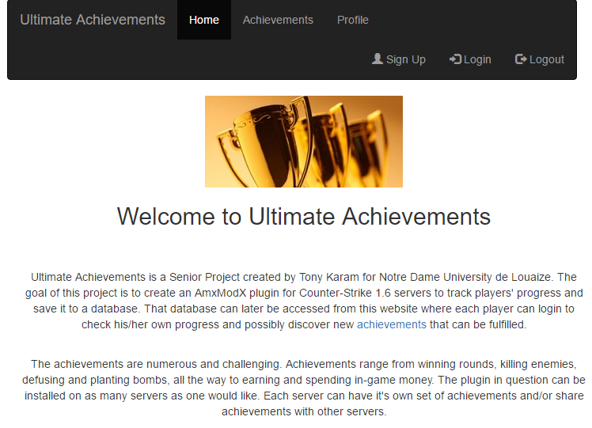
Part 2 - Website
6 Pages:
Home
Sign up
Login
Logout
Achievements
Profile
User Friendly
Secure

Slide 9
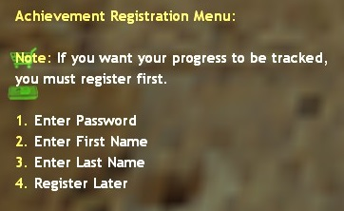
Part 3 - Plugin
Player Registration
Player Login & Logout
Achievement Tracking
Progress Saving
MySQL

Slide 10
Implementation
Chapter 2

Slide 11
Plugin
Plugin Natives
Client Natives
Achievement Tracking
plugin_init( )
Called on Plugin Initializations
Event Hooks
Command Registrations
Plugin Registration
plugin_end( )
Called on Plugin Unload
Free SQL Handle
client_authorized( )
Called when player authorized
Clear player bits
Clear player data
Clear player progress
Call MySQL_Playerconnected( )
client_disconnected( )
Call MySQL_SavePlayerStats( )
Achievement specific hooks
Deaths
Headshots
Kills
Knife Kills
Pistol Kills
Round Wins
Achievement Wins

Slide 12
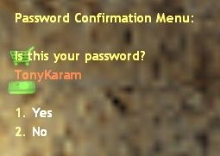
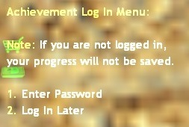

Plugin
MySQL
Menus
Initialization
Player Registration
Check if registered
Enable/Disable registration
Player Login
Player Stats
Read
Save
Insert
Login Menu
Password Confirmation Menu
Registration Menu
Password
First Name
Last Name

Slide 13
Results
Chapter 3

Slide 14
Results
Security
User Friendly
Passwords never stored in plain text
Passwords hashed with salt
Salt randomly generated
Project fully automated after installation
Easy installation procedure
Player friendly

Slide 15
Thank You!
Tony Karam - 20112214

